Slide 1
Kia/Hyundai Theft Wave: Is Your Car Next?
Alex Spence
DSC 640 Week 5-6 Assignment

Slide 2
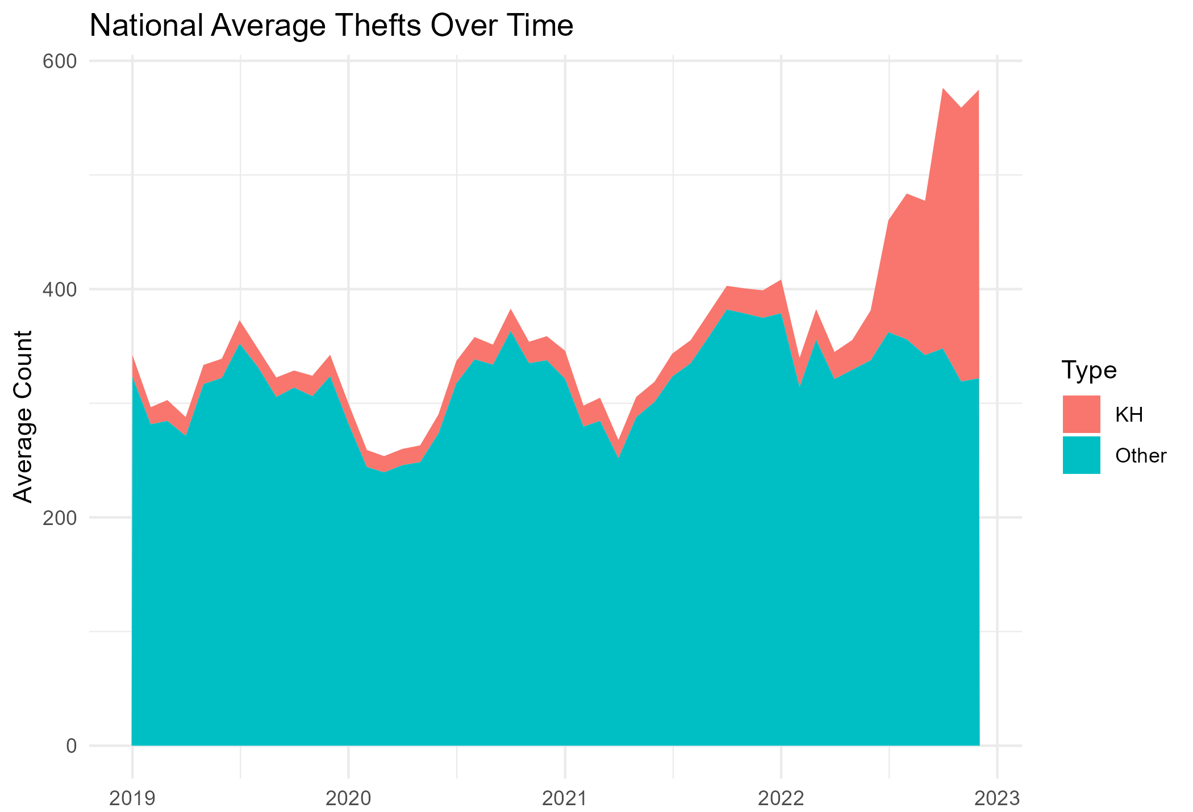
National Theft Surge
Kia/Hyundai thefts surged nationally, reaching up to 70% of total thefts in some cities (2019-2022 data)

Slide 3
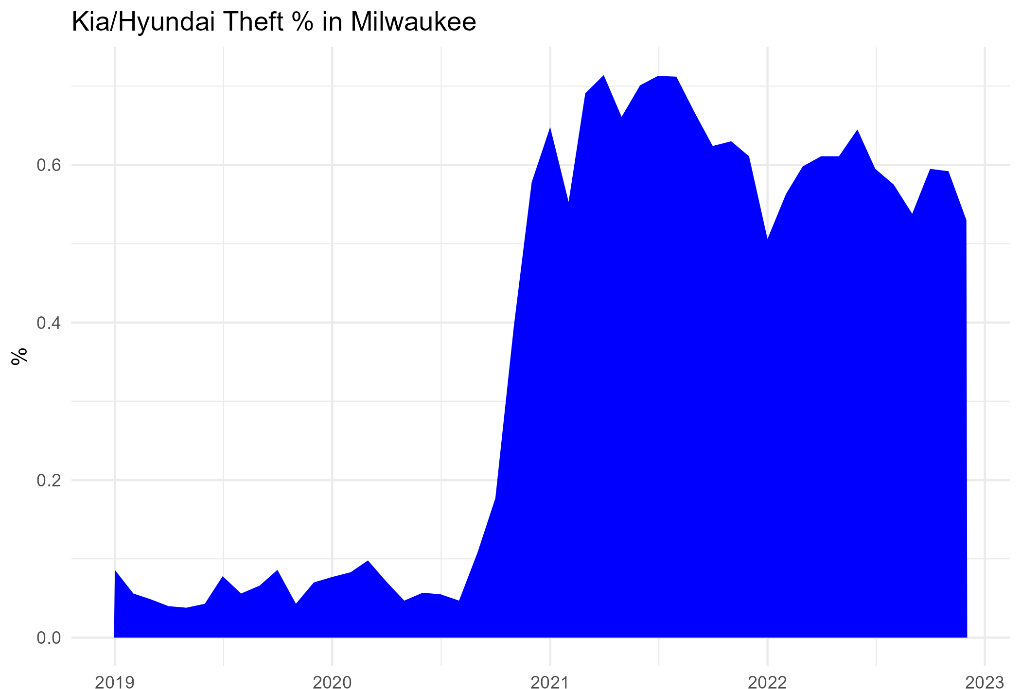
Milwaukee Deep Dive
Thefts in Milwaukee jumped from 5% to over 60% (2019-2022 data)

Slide 4
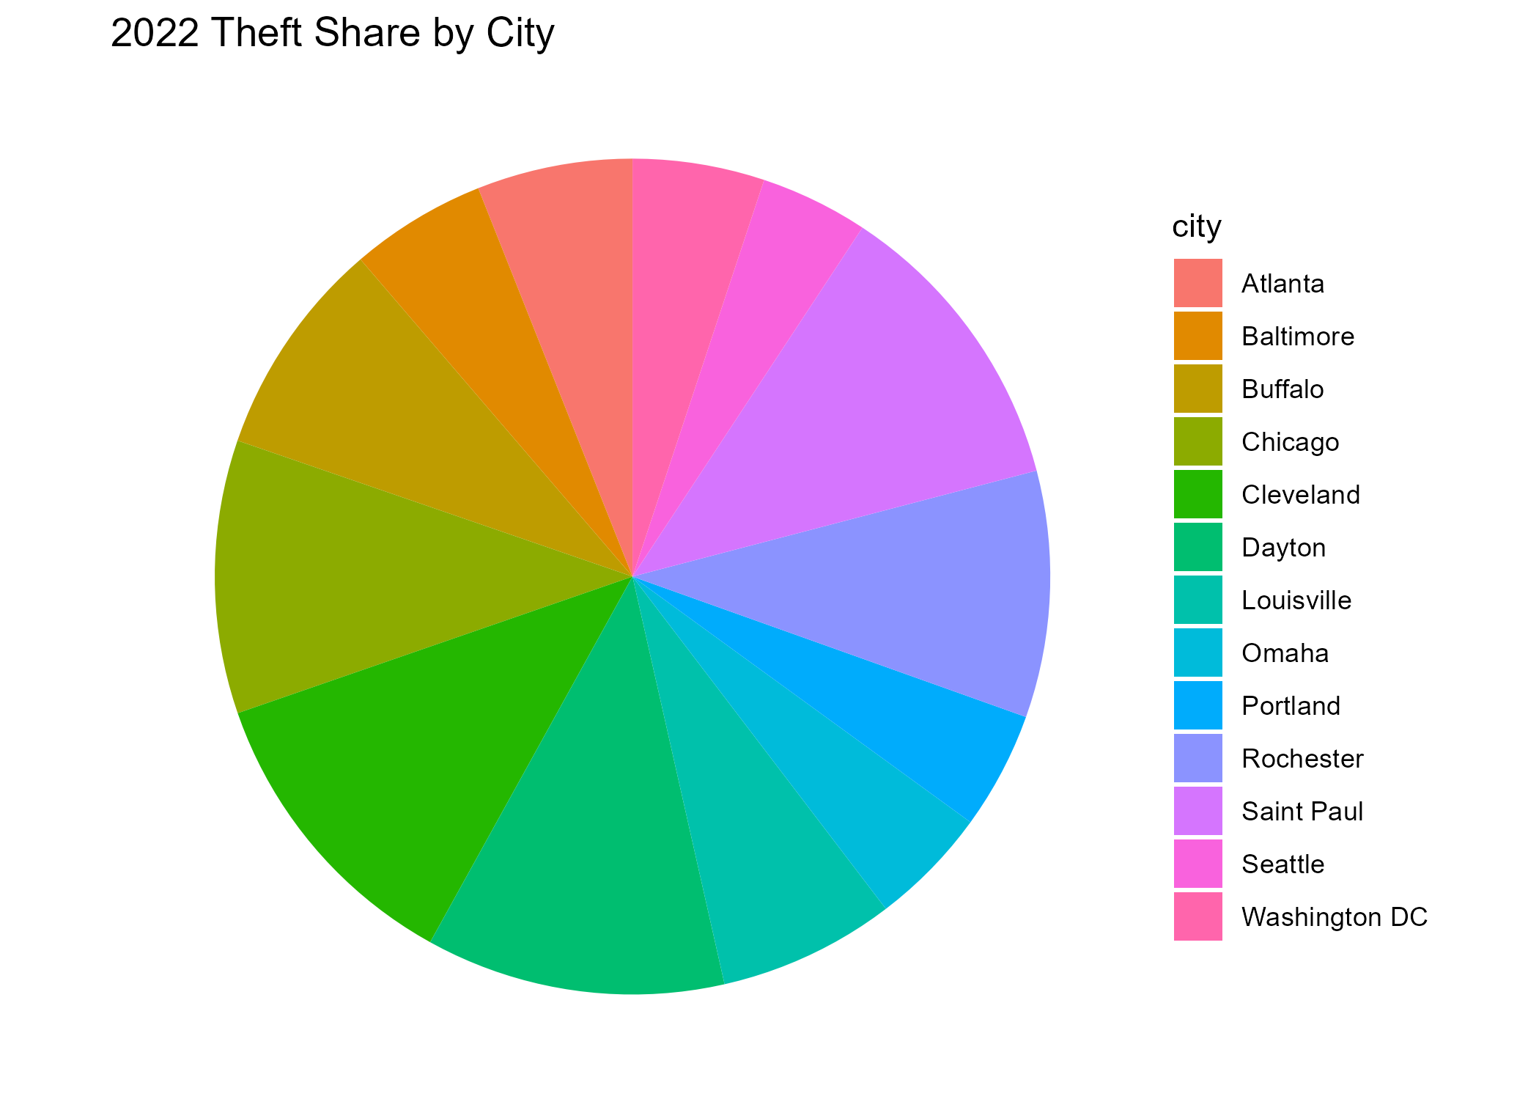
City Comparisons
Hotspots like Seattle (31%) vs. Atlanta (10%) in 2022 (2019-2022 data)

Slide 5
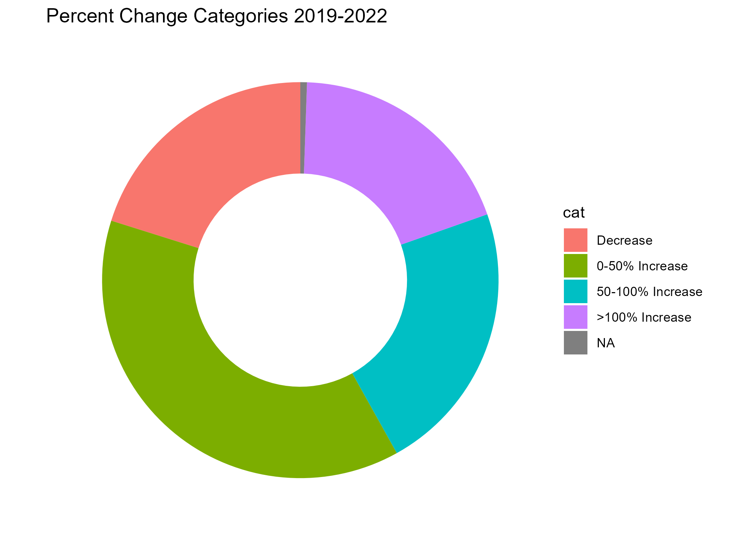
Geographic Impact
Seattle +211%, Milwaukee +195% (2019-2022 data)

Slide 6
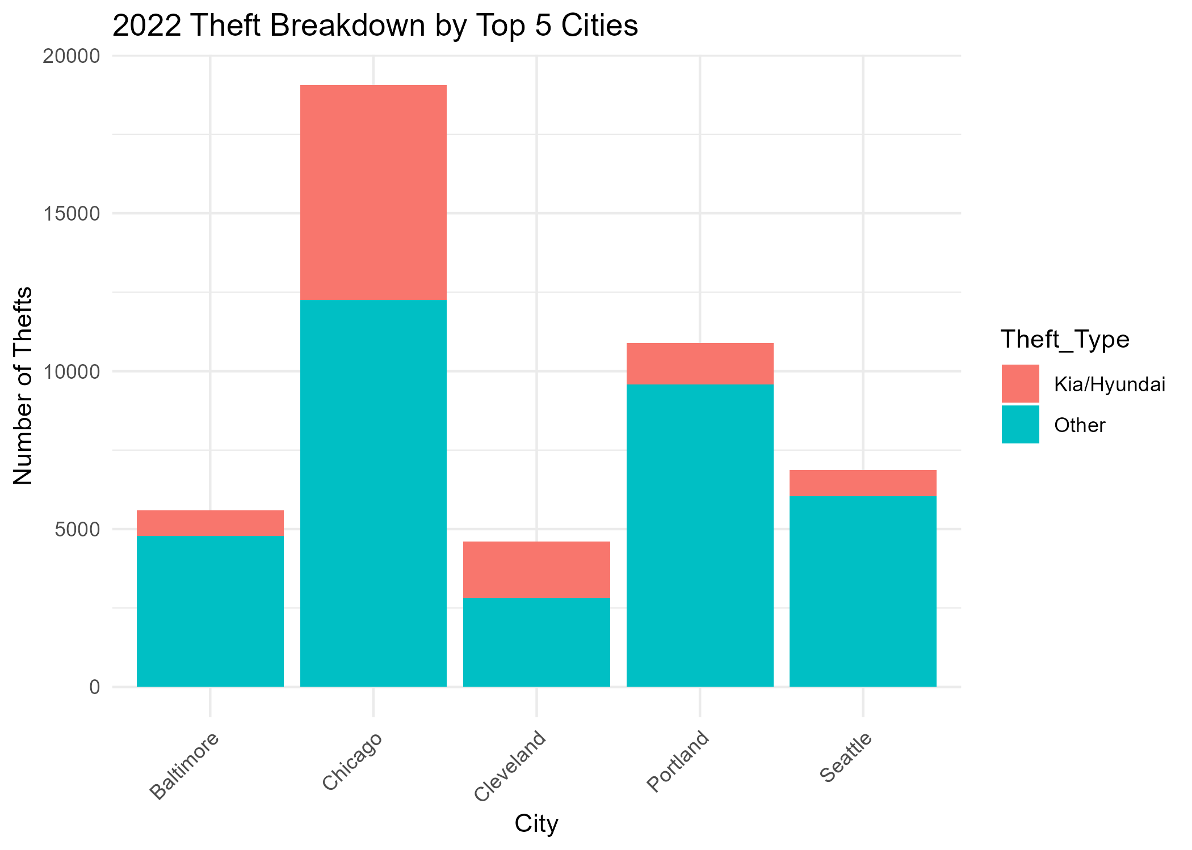
Thefts By City
Chicago has been the top theft city in 2022

Slide 7
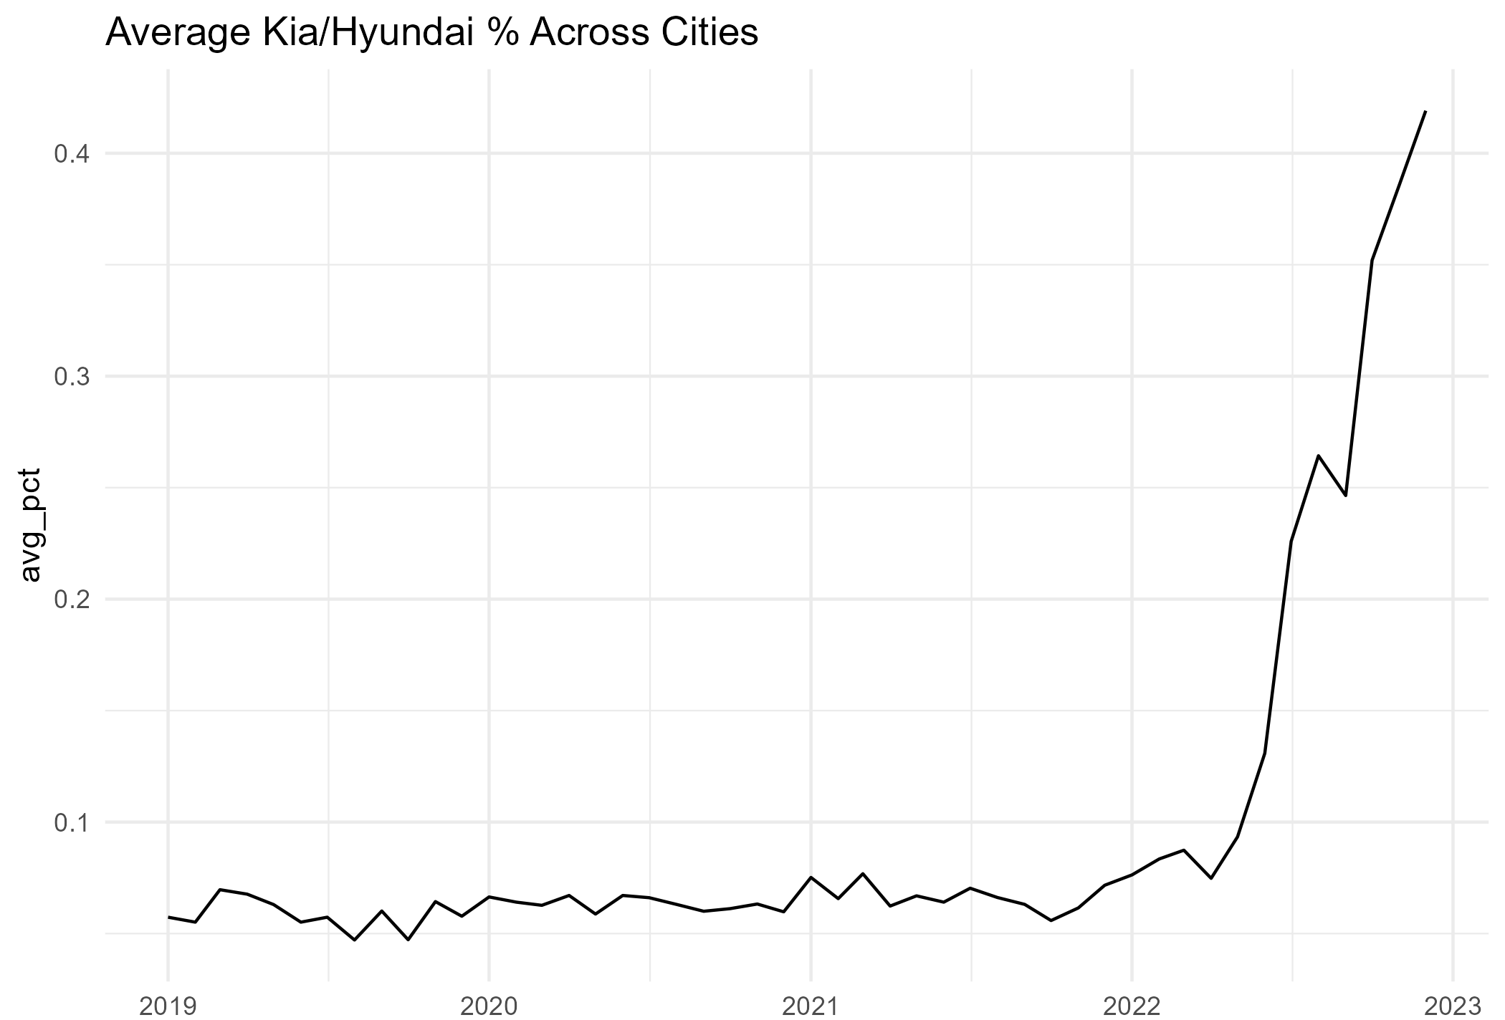
Overall Risk
Average Kia/Hyundai theft percentage rose sharply (2019-2022 data)

Slide 8
Call to Action
If you own a 2011-2022 Kia/Hyundai, get the free anti-theft software update at your dealer today! Visit kia.com/anti-theft or hyundai.com/update to schedule and protect your vehicle!

